Slide 1
FHIR Query Generation
A multi-pronged strategy to help users build correct FHIR request and improve their knowledge of FHIR
Patrick W. Jamieson, M.D.
Product Manager, FHIR Core

Slide 2
Project Goals
Enhancing Usability: Simplifying the query generation process for new users to reduce their learning curve, making our FHIR platform more accessible to a broader range of healthcare professionals and researchers.
Promoting Standardization: Encouraging the use of valid FHIR queries to maintain the integrity and standardization of data exchange, which is vital for interoperability.
Supporting Innovation: Support innovators and developers so they can more readily create new applications and services that utilize healthcare data on our FHIR platform.

Slide 3
Input Question in Natural Language
Yes, store
In Chroma
Gold Standard Data
(Chroma)
Vector DB similarity search
Chroma
Match Good?
No
Yes
Query + Explanation to User
Vector DB RAG search (Pinecone)
Feed Query into FHIR server
No, either edit or reject
Optional Feedback
Loop
Expert Agrees
Resp 200
Yes
Query + Explanation to User
No
Feed Output into Explain
Yes

Slide 4
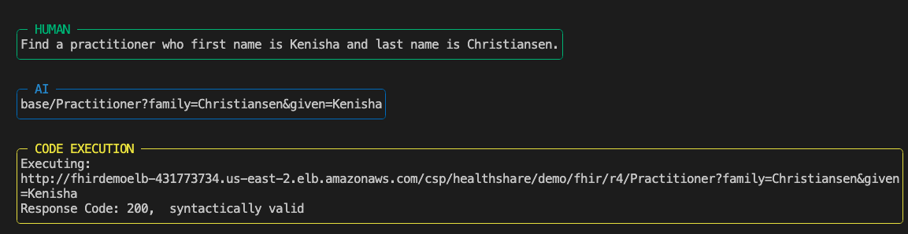
Simple FHIR Query
Actual Screen Shot

Slide 5
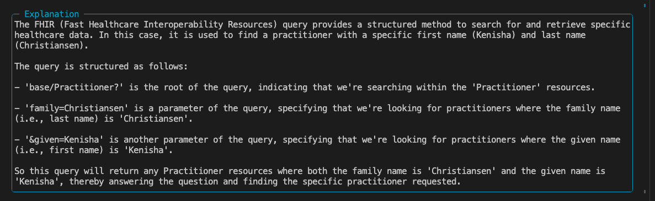
Step By Step Explanation
Actual Screen Shot

Slide 6
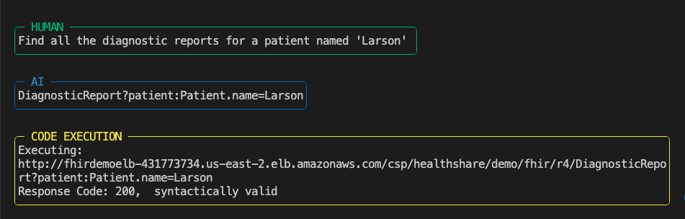
Intermediate FHIR Query using Chaining
Actual Screen Shot

Slide 7
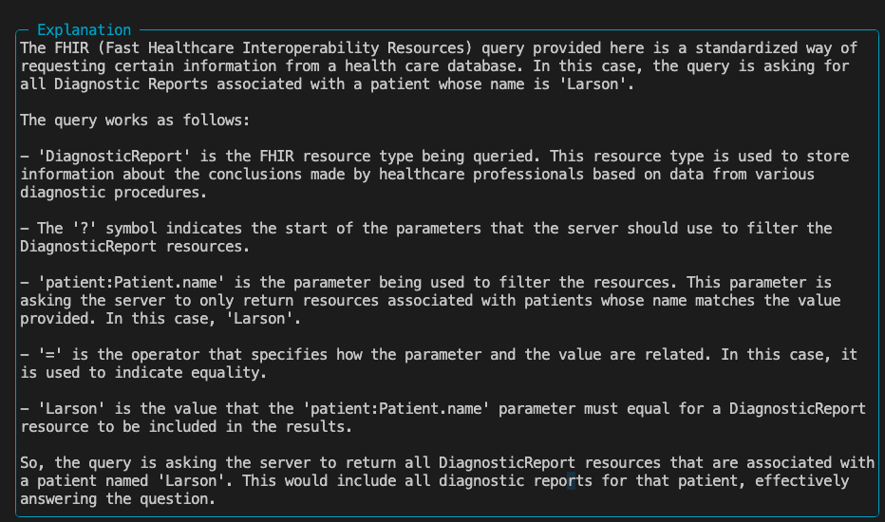
Step By Step Explanation
Actual Screen Shot

Slide 8
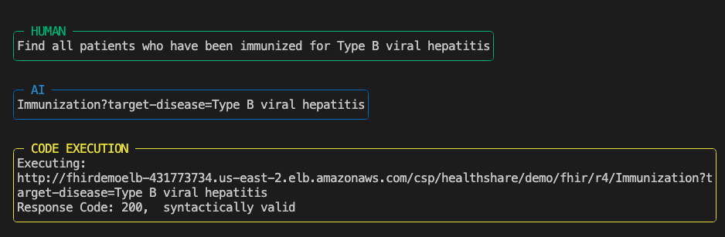
Where Open AI Fails
Actual Screen Shot
When searching by target-disease only ‘tokens’ are permitted which in this case is:
http://snomed.info/sct|66071002

Slide 9
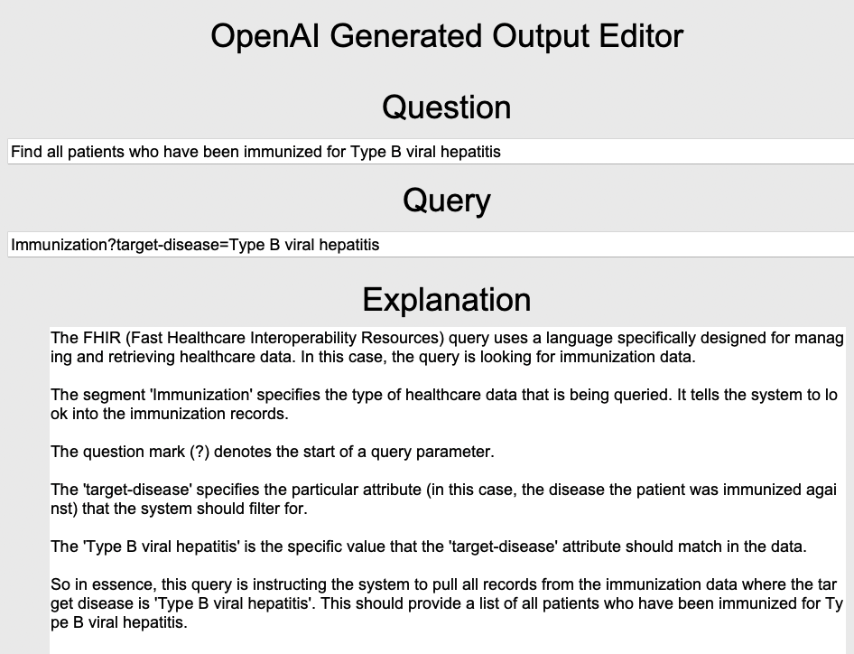
Note that this query did not use a token
Actual Screen Shot

Slide 10
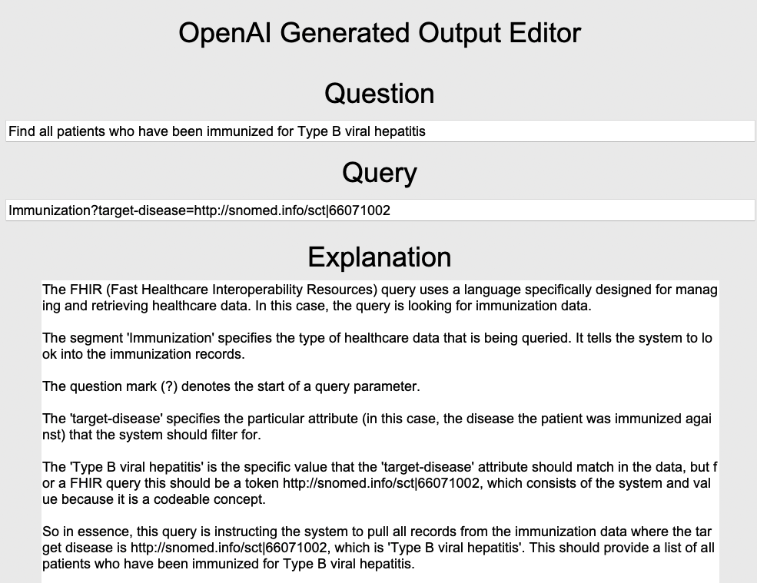
Fixing the Query and Explanation
Revised
query
Revised
explanation

Slide 11
Next Steps
Build REST APIs for input and output to the GenAI system
Add additional training material for Gold Standard Answers
Modify tuning parameters if have time

Slide 12
Unanswered Questions
Are there additional sources of document data to improve FHIR query generation using RAG (currently 2400 documents)?
What is an acceptable error rate? (theory 2%)
How many Gold Standard questions are needed for training to get to an acceptable error rate?
What other capabilities should tool have to make process simpler – guided prompts?, specific types of explanation? , other?

